Slide 1

New Member Education Overview

Slide 2
WHAT IS A NEW MEMBER PROGRAM?
WHY DOES IT EXIST?
The New Member program is the transition period from rushee to Brother.
The program aims to ensure all New Members have the same understanding and connection to AEPi as other Brothers in the chapter.
This is a time to learn how to effectively run an AEPi chapter, build confidence, gain new leadership skills and styles, make lifelong friendships, and learn about AEPi since its founding over 100 years ago.

Slide 3
ALPHA PHASE EDUCATION OVERVIEW
AEPi History
  AEPi’s key dates and locations
  “Immortal 11”
  AEPi’s Mission Statement
  AEPi’s International Expansion
New Member Pin
Good & Welfare
Expectations of Membership
  Dues
  Participation
  Conduct
Robert’s Rules of Order
Health & Safety Policy (Find on www.aepi.org/health-and-safety)

Slide 4
AEPi History
Why are we teaching this? - Every member of Alpha Epsilon Pi should have a basic understanding of how the fraternity was founded and why.
Charles C. Moskowitz decided to start his own Fraternity for Jewish collegiate men because fraternities at the time did not allow Jewish men to join their organizations
Alpha Epsilon Pi was founded in 1913 under the Washington Square Arch at New York University (NYU) by Charles C. Moskowitz and 10 other Jewish men
The founders would become known as the Immortal 11

Slide 5
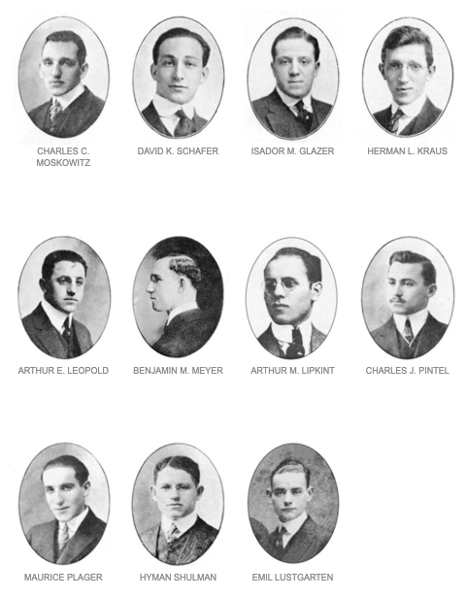
AEPi History

Slide 6

AEPi History
Notes:
https://www.youtube.com/watch?v=1rRS1JWR4xw&t=1481s

Slide 7
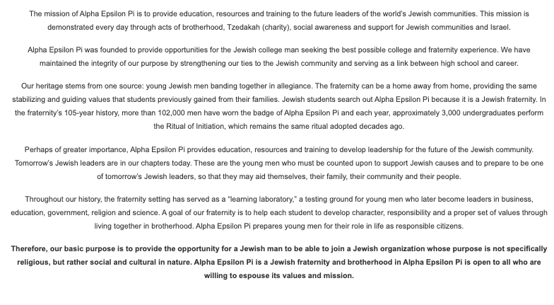
AEPi History - Our Mission
Notes:
https://www.youtube.com/watch?v=1rRS1JWR4xw&t=1481s

Slide 8
A Note on International History
AEPi began expanding to universities outside of North America in 2009 with the founding of IDC Herzliya. This chapter is known as Aleph/ Israel Alpha.
In 2011, a Brother from St. Andrews (Scotland) named Elliot Miskin heard of AEPi through the movie “The Social Network.” He decided to see if this organization actually existed. After some research and a quick phone call to AEPi’s HQ, AEPi began in the UK. This chapter is known as Upsilon Kappa Alpha.
Currently these are the Chapters and colonies outside of North-America
Israel: Aleph - IDC Bet - Hebrew U Dalet - Ben Gurion Hay - Tel Aviv U Vav - Bar Ilan U Chet - ORT Braude | UK: YKA - St. Andrews YKB - Leeds YKG - Birmingham YKD - Nottingham YKE - London | Australia: AUM - Melbourne Metro OZA - Sydney Metro

Slide 9
Current AEPi by the Numbers:
170 chapter/colonies
Chapters in six countries
99,000 living Brothers
In the 2019-20 school year we had 76 Student Body and IFC officers, 16 of them are the presidents
Over 500K raised annually for philanthropy (for both AEPi and other charities)
Hundreds of Brothers go on Birthright each year
Roughly 2,500 attendees in regional conferences
Hundreds of Brothers attend international convention every year
  This year is Atlanta Marriott Marquis in Atlanta, GA July 29-Aug 2

Slide 10
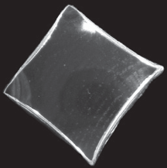
New Member Pin - The Values of AEPi
Five Values of the new member pin represented by four sides and the blue center:
Perseverance
Humility
Mutual Helpfulness
Faith
Center represents Honesty
Sides are curved to show that the roads in life are not always straight

Slide 11
New Member Pin (cont.)
Side 1: Perseverance
Perseverance is a cornerstone of the Jewish culture. In our history, we have been knocked down many times. It is the Jewish tradition of to never give up. When a challenge is presented, we get innovative and we find new solutions to old problems.
Side 2: Humility
Humility is the understanding that as humans, we make mistakes and take wrong positions. As a Brother of AEPi, one must own their humility and understand when they are wrong and work to right that wrong.

Slide 12
New Member Pin (cont.)
Side 3: Mutual Helpfulness
The founders were close and were concerned about each other’s welfare; they overlooked each other’s shortcomings, and tried to assist each other’s development. They did things together and enjoyed doing them together.
Side 4: Faith
The founders had faith in G-d, in their country, in their university and in themselves. They believed with all their hearts that they had a G-d given opportunity to create an ethical fraternity. They had faith in their ability to accomplish these goals. With faith as a guidepost of their fraternal striving, they succeeded.

Slide 13
New Member Pin (cont.)
Center of the Pin: Blue for Honesty
The founders were honest with themselves. They recognized their limitations. They also recognized that there was no limitation on hard work and ambition, if it was made by honest effort. Honesty with each other became a keystone of the fraternity from the beginning.

Slide 14
Good and Welfare
At the end of every chapter meeting (and whenever else it is deemed necessary), it is customary to pass a gavel around the room and give each member the floor to speak freely about anything that has been going on since the previous Good and Welfare. Typically, Brothers speak about the good in their life like significant accomplishments or fun events they have attended recently, as well as some negatives like a tough exam or your favorite team losing this week. This is a staple of every single chapter in AEPi and differentiates the Brotherhood from just any old organization or business.
The traditional G&W is started when you place the gavel over your heart, stand up, and recite:
“For the Good and Welfare of the __ Chapter/colony of the Alpha Epsilon Pi Fraternity, Brother Master and Brothers here assembled, I hereby give my Good and Welfare.”
You can then speak freely, and when finished you should say, ​“And with that I yield.”

Slide 15
Expectations of Membership
Every active Alpha Epsilon Pi Brother is responsible for paying fees to the International Headquarters (IHQ) every semester. These fees include insurance and operations. We cover this topic as early as possible to give the New Member time to figure out his payment options.
International Dues: $198.50 USD per Brother per semester || $495 USD* per New Member
Convention Dues: Refer to your ELC
*Upon completion of Greeklifeedu within one month after receiving a bid, a new member will receive $90 off their dues.
Please refer to the Return on Investment Document for a list of benefits of membership

Slide 16
Robert’s Rules of Order
Robert's Rules are age-old guidelines that are designed to aid your discussion and limit unnecessary arguments while providing your members ample opportunity to speak. Please take note of the attached Robert's Rules of order brief and make sure your members (especially the new ones) know the basics.
Please refer to the Running a Successful Chapter Meeting Document for info on Robert’s Rules of Order and general chapter meeting structure.

Slide 17
EPSILON PHASE EDUCATION OVERVIEW
Organizational structure of AEPi IHQ
Executive board and their roles
Minor Board and their roles
Local History
The Cofa
Greek Alphabet

Slide 18
Structure of AEPi IHQ and Locally
Why are we teaching this? - Understanding the structure of the fraternity from top to bottom will teach you just how large AEPi is and give them background into the way we operate on an International level.
On the chapter level, it offers opportunities for leadership and professional development. Holding such positions will give you a tremendous amount of leadership experience.

Slide 19
AEPi IHQ Structure
AEPi Fraternity, Inc - This is the fraternity part of Alpha Epsilon Pi. This branch is in charge of chapter operations and programming. They work with chapters across the world to ensure every male has an opportunity to take part in the Jewish Fraternal experience.
The AEPi Foundation - The Foundation. It is responsible for supporting AEPi through grant writing and donations. They raise money by contacting donors and by planning and executing fundraising events.
ESPONDA Associates - Esponda Associates is responsible for all the chapter houses in the United States. Everything from buying the property and rent collection to maintenance is dealt with by the Esponda Associates.

Slide 20
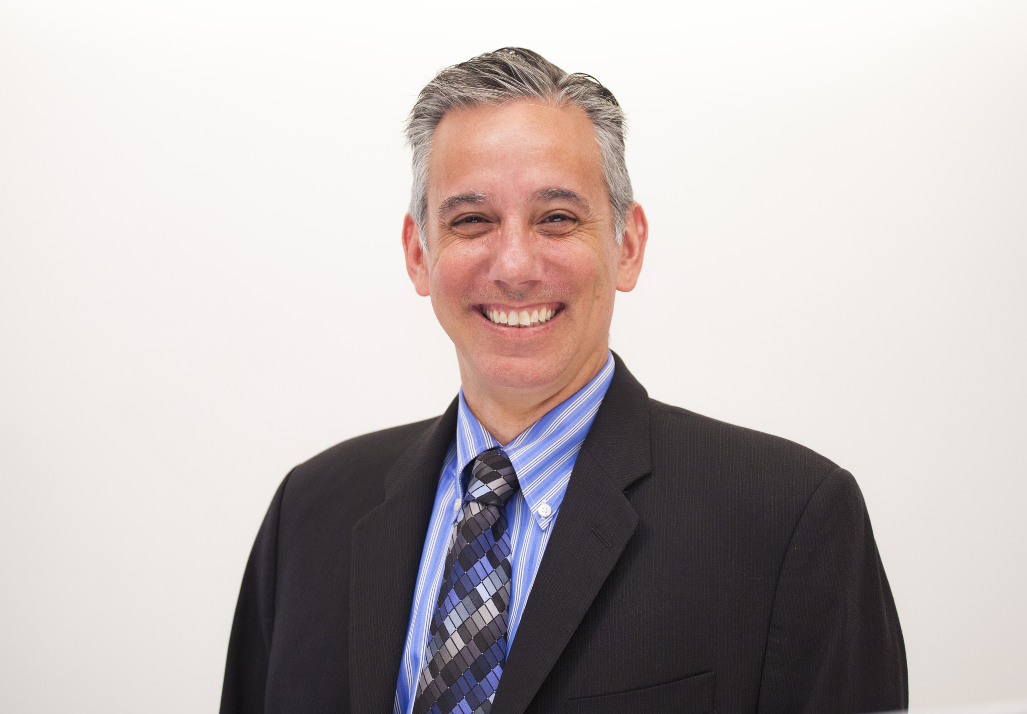
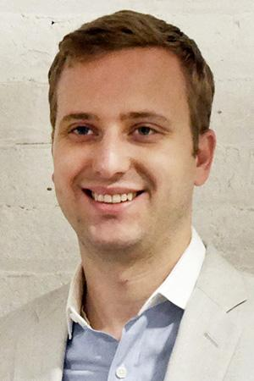
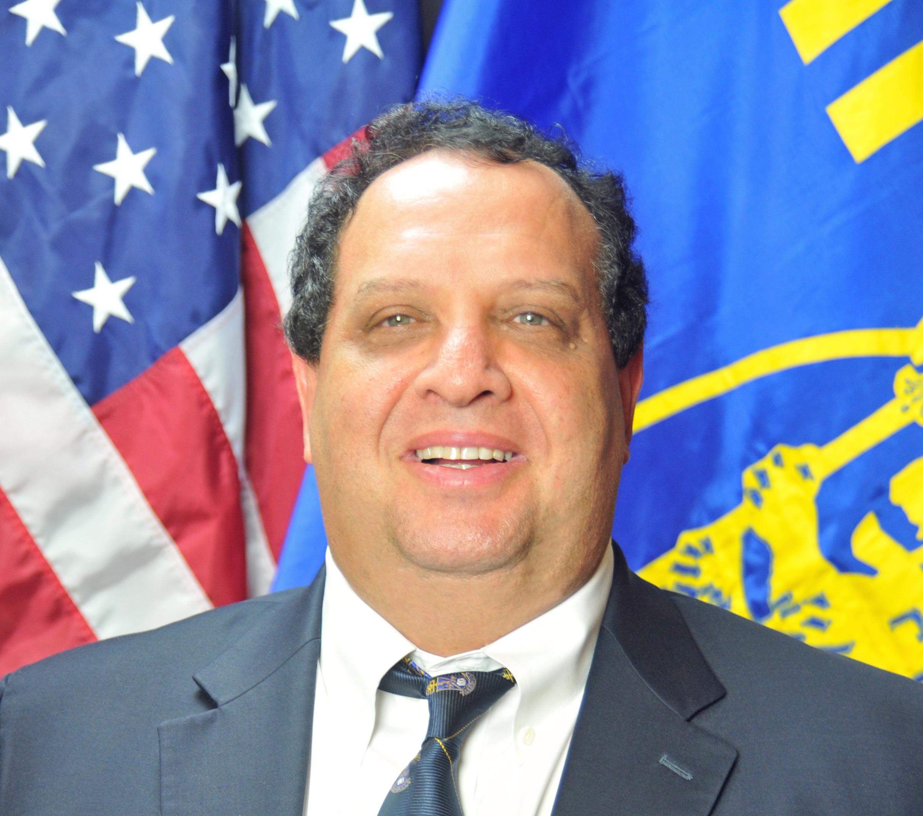
Important Names & Faces
Jim Fleischer
Rob Derdiger
Andrew Borans
CEO of AEPi
Oversees operations of the International Fraternity
Managing Director of ESPONDA Associates/ CFO AEPi
Oversees operations of housing related commitments and the International Fraternity’s finances
CEO of AEPi Foundation
Oversees the fundraising operations of the Foundation

Slide 21
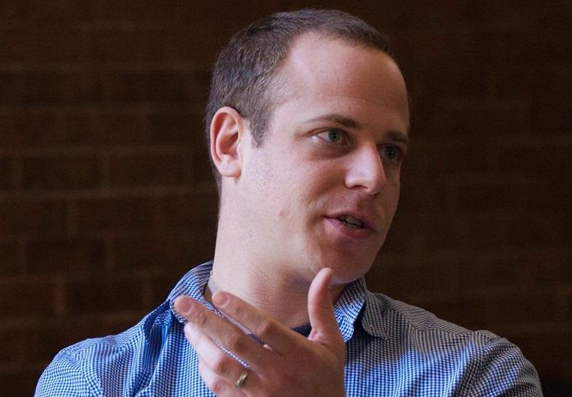
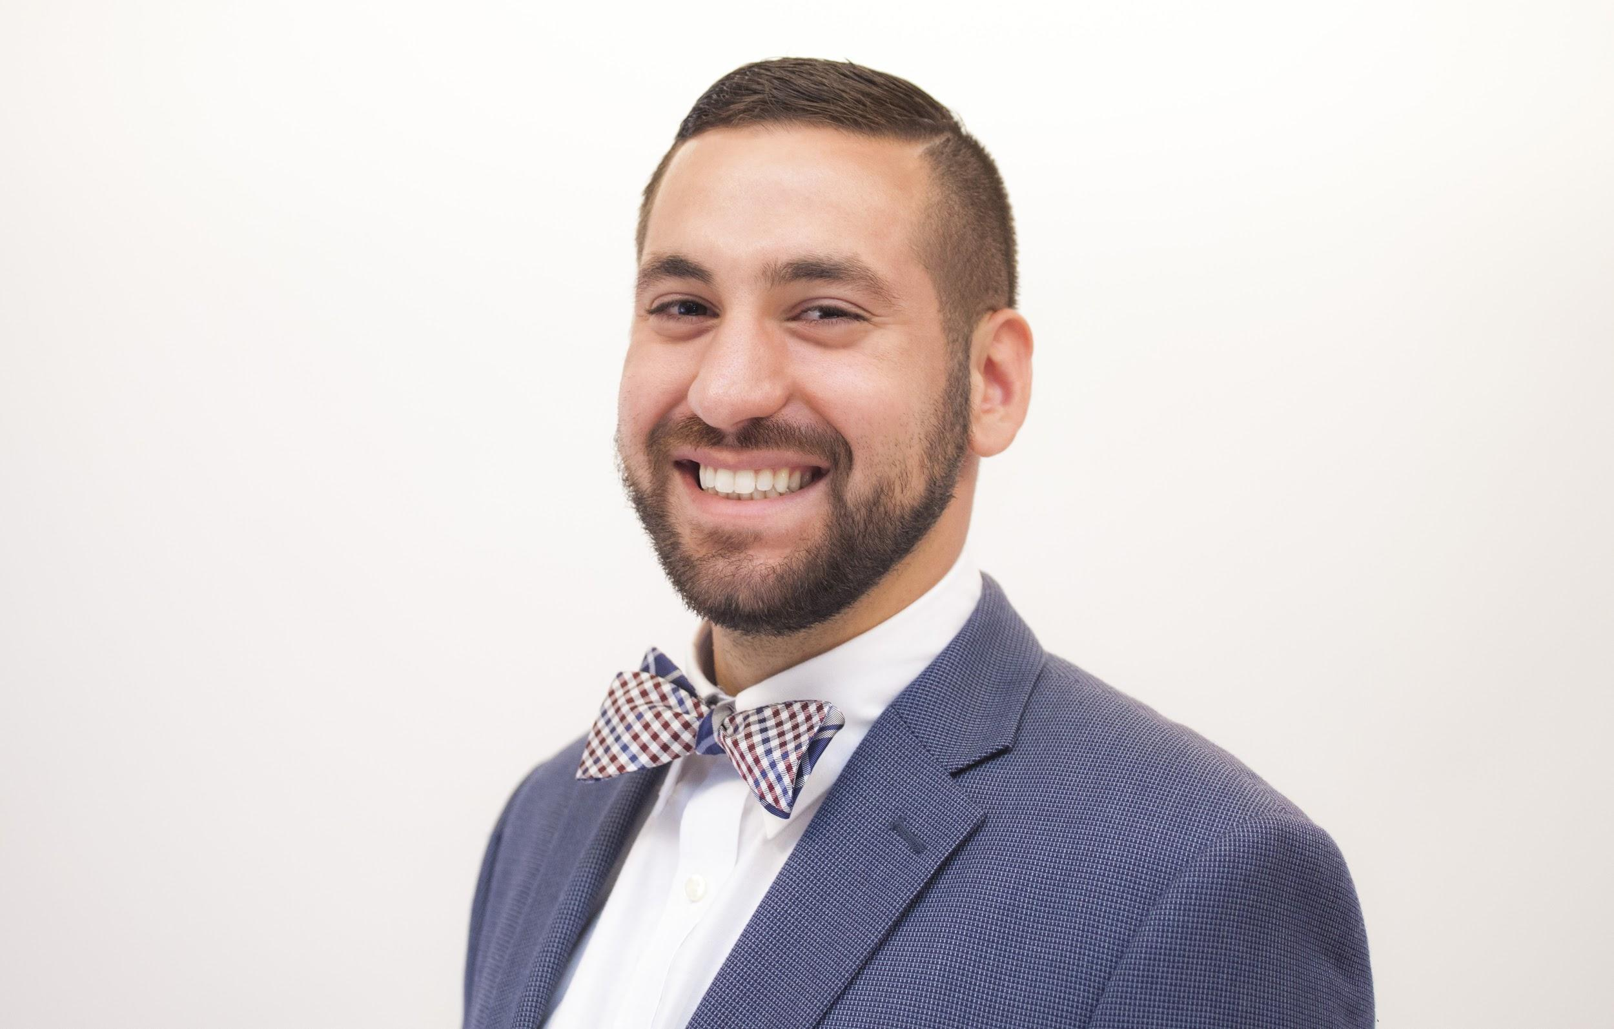
Important Names & Faces (cont.)
Jason Kirschtel
Andrew Neiberg
Kyle Whitlock
Director of Chapter Services
Advises ELCs and chapters on health and safety, finances, chapter operations and structure.
Director of Campus Operations
Advises ELCs and chapters on best practices for operating on campus and works with campuses to work smarter and better with our chapters
Director of Leadership Development
Advises ELCs and chapters on best practices for fraternal education

Slide 22
Educational Leadership Consultant
Your ELC
Advises a region of chapters, working with them on day-to-day operations. These are the people you will see most often.

Slide 23
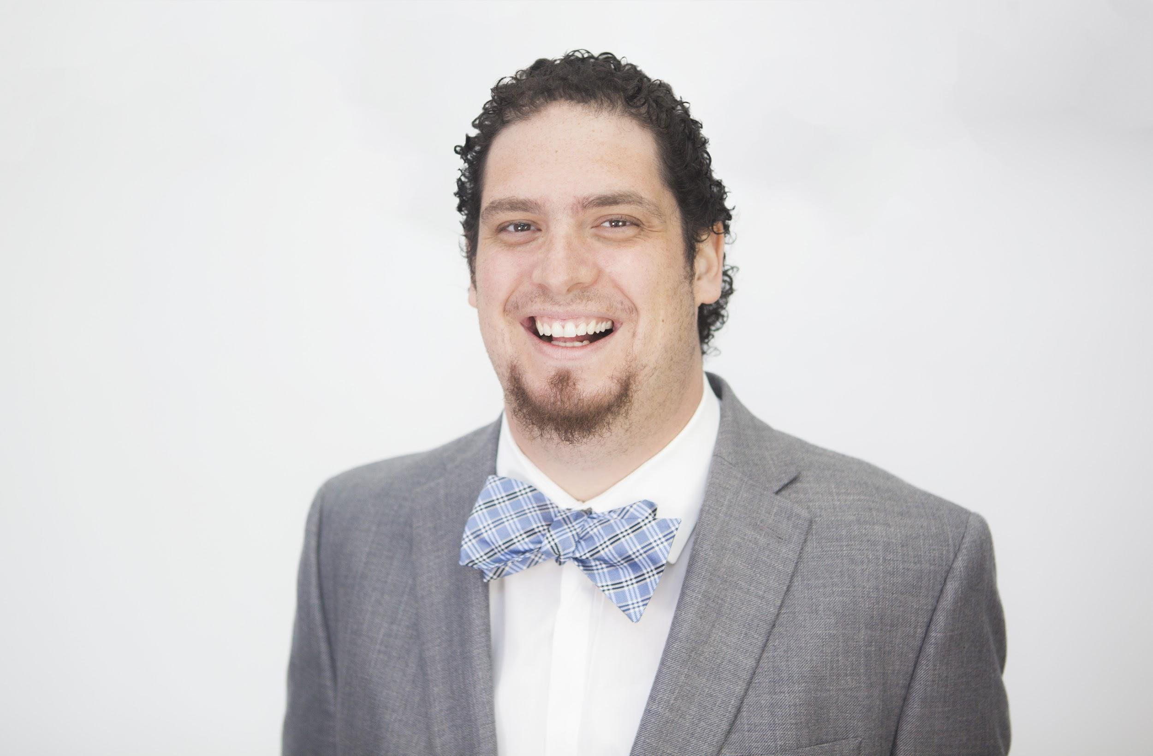
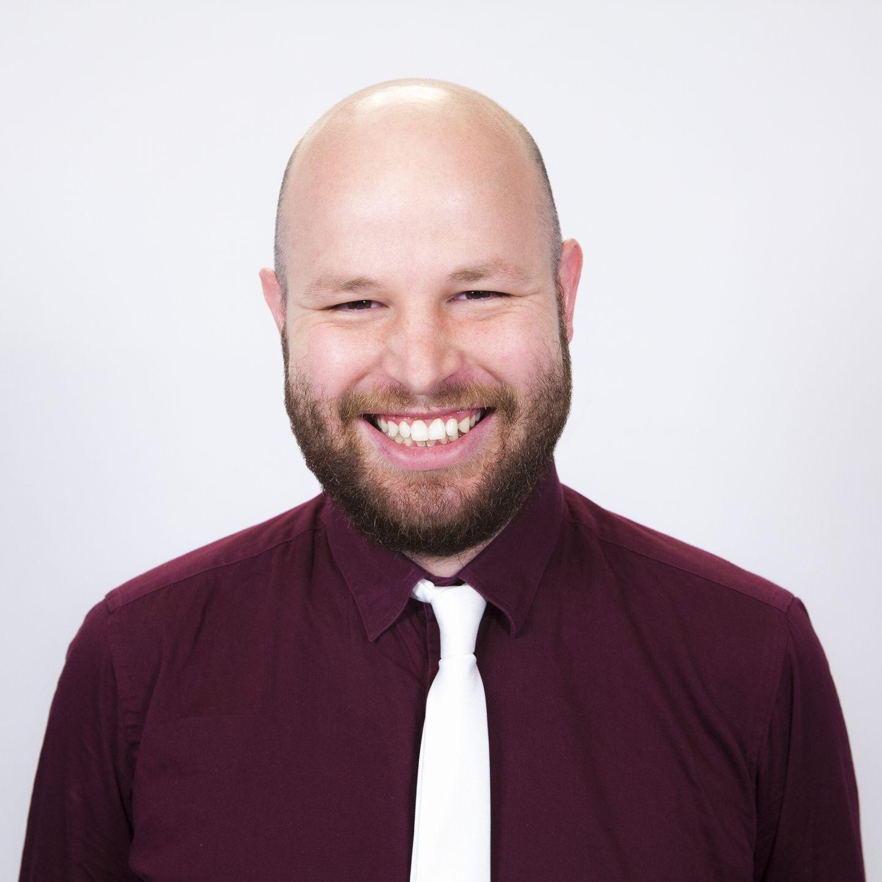
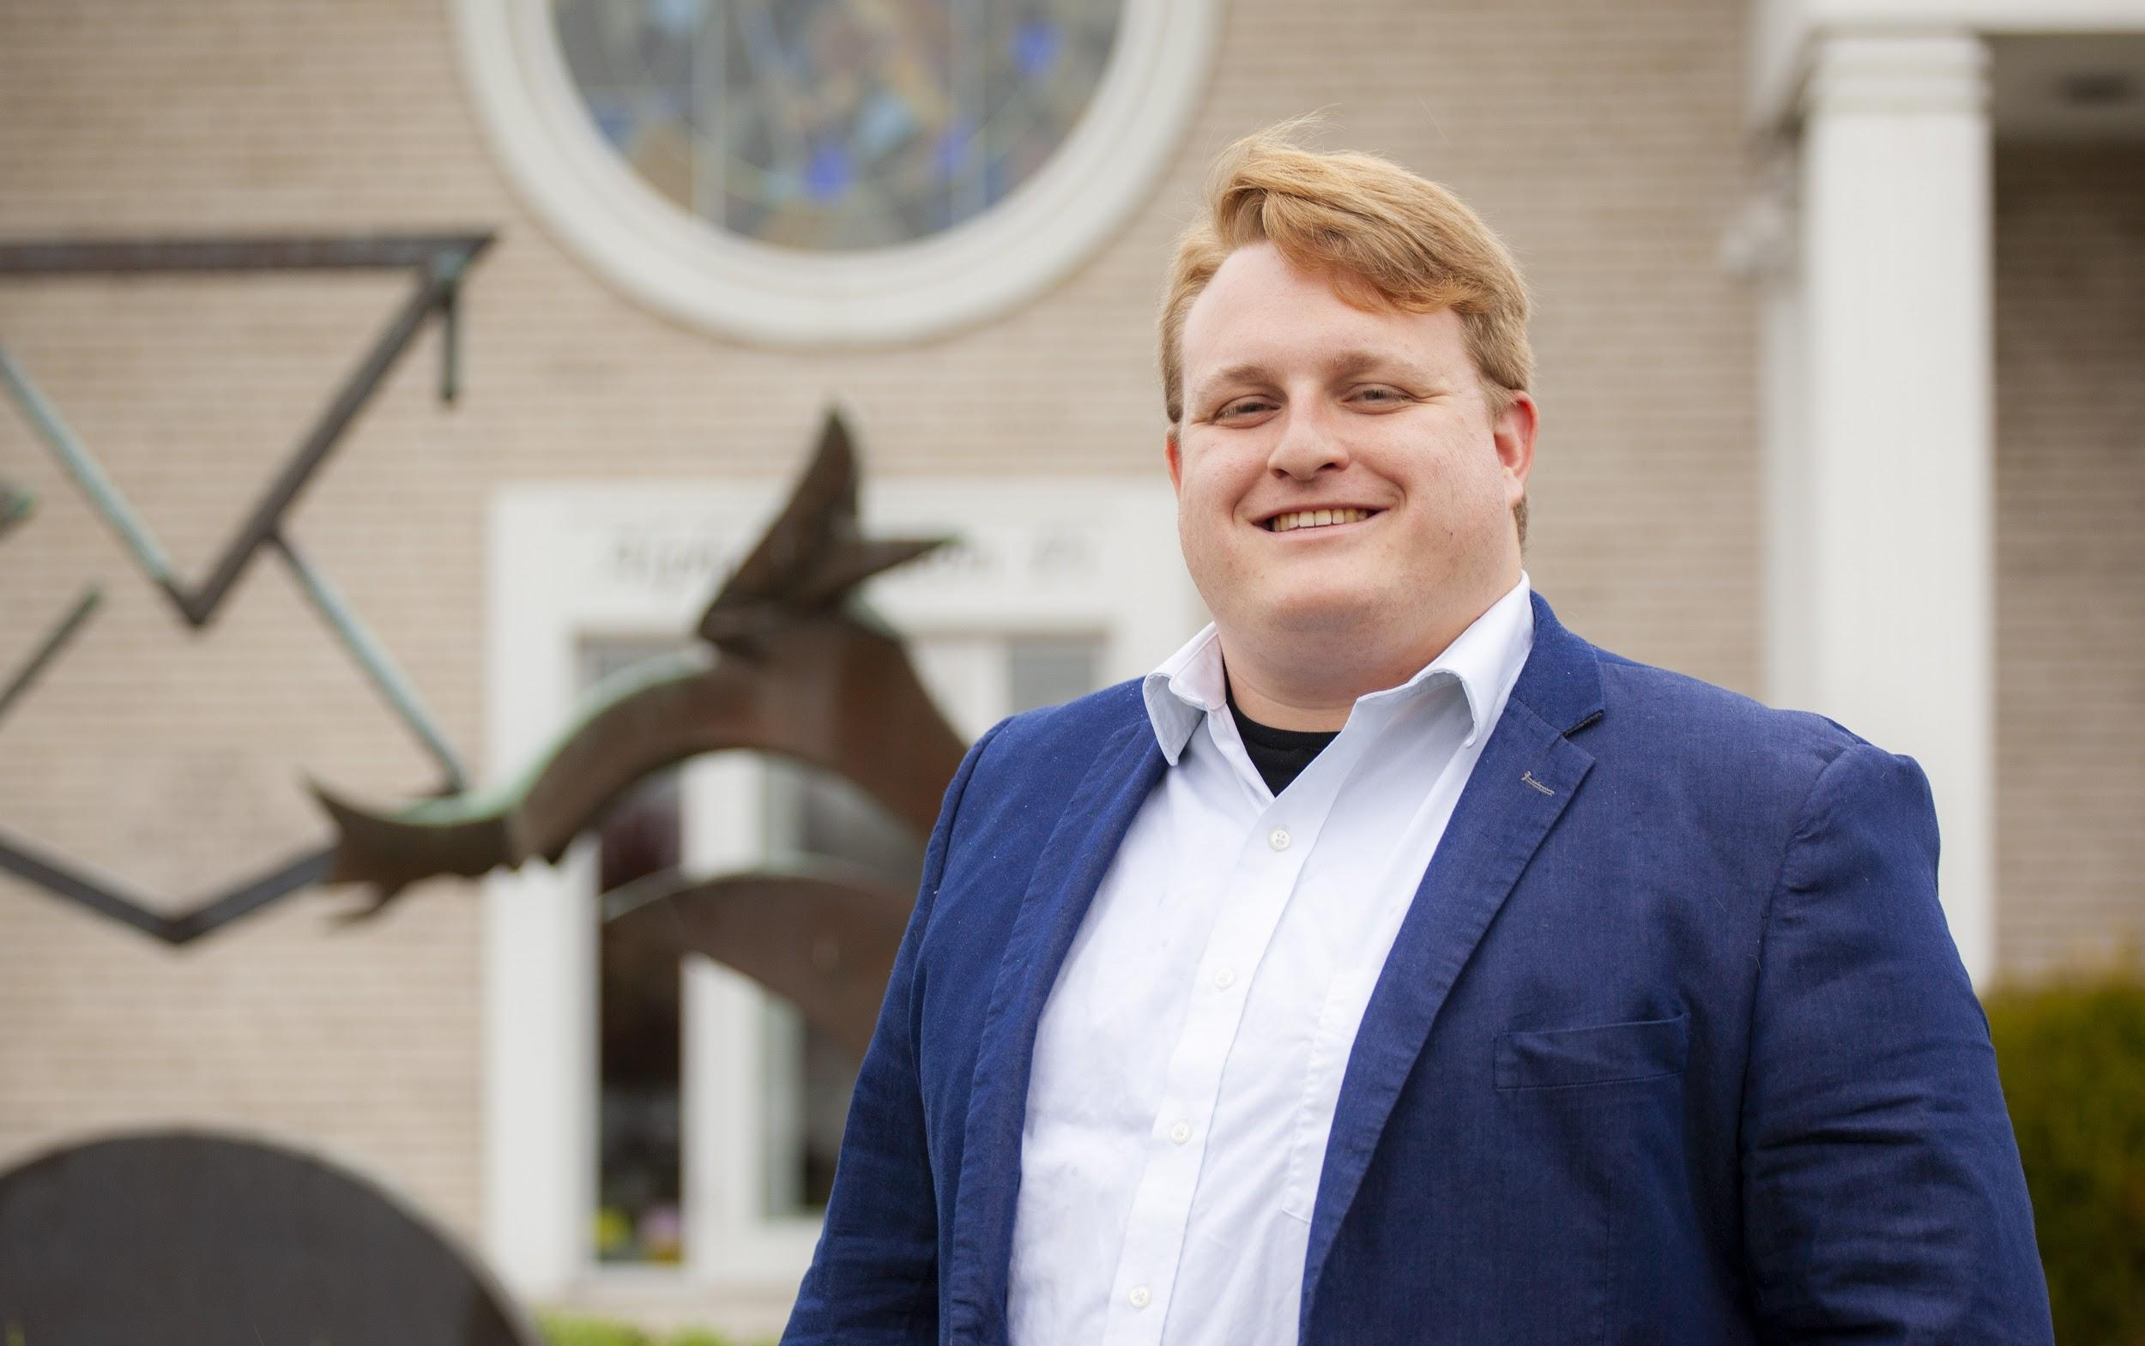
Jon Bridge
Moshe Lencer
Ethan White
Chief Programming officer
Oversees the programming department, works on partnerships and initiatives for undergrads
Director of Jewish Enrichment and Education
Supervises the Jewish Programming associates and works on Jewish and Israel related educational initiatives
Jewish and Israel Programming coordinator
Oversees special projects and initiatives

Slide 24
Jewish Programming Associate
Your JPA
Advises regions of chapters, working with them on day-to-day operations in the realm of programming and Jewish involvement

Slide 25
The Executive Board and their Roles
Eboard is made up of:
Brother Master (CEO)
Lieutenant Master (COO)
Scribe (Chief Secretary)
Exchequer (CFO)
Sentinel (Sergeant at Arms / Health & Safety Officer)
Brother at Large (Optional +35 members) (Human Resources)
Rush (Optional +35 members) (Recruiter)
New Member Educator (Optional +35 groups) (Onboarding)

Slide 26
Brother Master (CEO)
Expectations include:
Maintain safety of the chapter and its members.
Know and enforce AEPi policies - especially those regarding health & safety including sexual assault prevention, alcohol/substance abuse, hazing prevention, fire safety and security, and Good Samaritan.
Provide vision and direction for the chapter in alignment with the values of Alpha Epsilon Pi.
Manage the executive board and hold them accountable for accomplishing tasks that fall in line with his vision.
Communicate and act as a liaison to the ELC,International Headquarters, university or college, and local community.

Slide 27
Lieutenant Master (COO)
Expectations include:
Assist and support the Master in his decisions.
Know and enforce AEPi policies - especially those regarding health & safety including sexual assault prevention, alcohol/substance abuse, hazing prevention, fire safety and security, and Good Samaritan.
Appoint and manage an effective minor board aligned with the chapter vision.
Plan and execute chapter programming that fulfills AEPi’s mission.
Report to E-board about minor board progression.
Oversees chairs and programming

Slide 28
Scribe (Chief Secretary)
Expectations include:
Be the chief communicator for the Chapter.
Know and enforce AEPi policies - especially those regarding health & safety including sexual assault prevention, alcohol/substance abuse, hazing prevention, fire safety and security, and Good Samaritan.
Handle all administrative, communicative, and logistical duties.
Keep and record the chapters weekly meeting minutes.
Plan and distribute the calendar of events for the semester.
Manage roster and internal communication infrastructure of the Chapter.
Create and maintain an effective external chapter communication strategy.

Slide 29
Exchequer (CFO)
Expectations include:
Know and enforce AEPi policies - especially those regarding health & safety including sexual assault prevention, alcohol/substance abuse, hazing prevention, fire safety and security, and Good Samaritan.
Collect Brother dues by the first chapter meeting and set a deadline for payment plans to be signed.
Budget and distribute chapter funds
Oversee chapter balance sheet
Seek out fundraising and sponsorship opportunities
Report on chapter finances to chapter

Slide 30
Sentinel (Sergeant-at-Arms / H&S Officer)
Expectations include:
Know and enforce AEPi policies - especially those regarding health & safety including sexual assault prevention, alcohol/substance abuse, hazing prevention, fire safety and security, and Good Samaritan.
Collect Brother dues by the first chapter meeting and set a deadline for payment plans to be signed.
Budget and distribute chapter funds
Oversee chapter balance sheet
Seek out fundraising and sponsorship opportunities
Report on chapter finances to chapter

Slide 31
Brother At Large (HR)
Expectations include:
Maintain a positive atmosphere within brotherhood
Confront interpersonal issues between brothers to ensure cordial behavior and respect between brothers.
Work with Brotherhood Chair to plan and execute Brotherhood events
Serve as a liaison between E-Board and brotherhood
Serve as Sentinel for the rituals and meetings.
He shall be custodian of the Bible, Cofa, gowns, gavel, candles, and all other ritual
paraphernalia of the Chapter.
He shall perform the duties of parliamentarian for matters relating to parliamentary procedure, and shall familiarize himself with the rules of parliamentary procedure for this purpose.

Slide 32
Rush Chair (Recruiter)
Expectations include:
Create and execute a Chapter recruitment plan that will effectively recruit, vet, and select potential new members.
Ensure the Chapter is recruiting with AEPi values at the forefront.
Oversee the Rush Committee and ensure they are being held accountable
Communicate and work closely with the Rush Events Chair to ensure rush events are being planned and executed correctly

Slide 33
Why do we Rush?
To grow
To keep our name alive
To pass on the legacy of AEPi
To allow others to share in something that has become so important to us
To survive
*More on rush in Pi Phase*
Rush is the LIFEBLOOD of the Fraternity

Slide 34
New Member Educator (Onboarding)
Expectations include:
Inspire new members with the values and mission of Alpha Epsilon Pi
Train new members to become productive and contributing brothers of the Chapter
Make sure the new members are bonding not only with each other, but with the brothers as well
Educate the New Members how to run a chapter effectively
Educate the New Members on AEPi history and local chapter history
Encourage lasting participation

Slide 35
Minor Board
Your chapter’s minor board should be the backbone of your fraternity. All the planning, programming, and execution of fraternity events should be done by general membership who serve as chairmen or members of several different minor board committees.
A successful Lieutenant Master (COO) should regularly organize minor board meetings and ensure that all committees (and the chairmen of those committees) are working efficiently and within budget to fulfill the purpose of their committee for the chapter.

Slide 36
Minor Board Chairs
Brotherhood- Brotherhood is what unites us all together, the Brotherhood Chair helps to facilitate Brotherhood events and helps sustain the closeness that is a Fraternity
Jewish Identity(JIC) - This Chair and committee should be responsible for organizing Jewish events such as Shabbat dinners, holidays, break fasts, and Walk to Remember.
Philanthropy - Works to plan and create a successful chapter philanthropy event and ensures participation in other campus and chapter philanthropies.
Social Media - The Social Media Chair will be responsible for managing the chapters social media pages.
Civic Engagement(CEC) - Being civically engaged takes on many forms, the CEC helps chapter plan volunteering, get involved with campus and local elections and help the community grow
Israel Engagement(IEC) - The IEC works with the chapter and outside organization to help create and increase the relationship Brothers have with Israel
Social- The Social Chair and his committee organize the chapter’s social events.

Slide 37
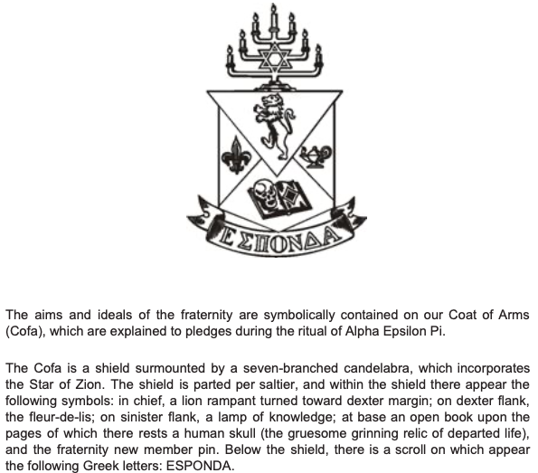
The COFA

Slide 38
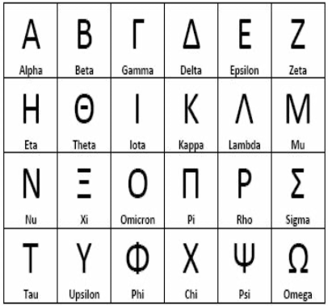
The Greek Alphabet

Slide 39
PI PHASE EDUCATION OVERVIEW
Rush Seminar (Preferably by ELC)
Health and Safety Seminar (By ELC or other staff)
Philanthropy Project
Alumni Seminar or Project

Slide 40
FINAL PROJECTS
Choose from either of the following (These should be announced during minor board day in Epsilon phase):
Philanthropy project - New Members will create and present a complete business plan outlining the event, logistics, and projected reach of the project. New Members will present their event to a board of judges who will critique and give suggestions. The judges can be senior members of the chapter, your ELC, your chapter advisor or a combination of all three.
Alumni Seminar - Working with your ELC and chapter advisor, reach out to local alumni to attend a seminar-type session. At this seminar, the alumni will share their experiences from their time in AEPi and explain how AEPi has affected their lives after college.

Slide 41
Initiation
Once you have successfully completed the New Member Program, the you are ready to be initiated into the Brotherhood. The chapter will ensure proper ritual is followed.
CONGRATULATIONS ON BECOMING A BROTHER.

