Slide 1
AEPi Virtual Programming
Different resources provided for virtual chapter programming

Slide 2
Virtual programming
AEPi as the international Jewish fraternity has committed itself to be a learning laboratory. During these news types we realized we can move to provide and show different ways to connect remotely, we have divided this into three levels of programming:
Staff Level
Undergraduate Level
Outside Organization Level

Slide 3
Staff Level
Recruitment seminar
Health and Safety seminar
Philanthropy seminar
Officer workshops
Motivating the middle
Public speaking
Leading teams
Effective meetings
Budgeting workshops
Staff-led workshops (contact Moshe Lencer at mlencer@aepi.org for details)

Slide 4
Staff Level
Continued
Developing your leadership style
Goal setting
Divergent thinking
AEPi history
Jewish programming 1on1
Going back to basics
NewMemberCore
Start with why

Slide 5
Staff Level
Continued
LinkedIn the AEPi Way
What, How, Why of Graduate School: Is it Worth it for you?
Dress for Success: Tips from a Professional Clothier
Professional Certifications: Finance
Having Faith in Your Faith. The Importance of Hope
Personal Finance Tips: Investing for tomorrow, today
College Campus Life: Past, Present, & Future
Getting into Real Estate: What you need to know
Staff Facilitated Webinars, go on www.aepi.org/events for dates and times

Slide 6
Staff Level
Continued
Cooking with AEPi: Live Demonstration with Chef Simon
Engaging at Home: Connecting with Your Kids
State of the Financial Markets: What's next
From Script to the Theatre: Movie Production Process
Future of Sports
From Idea to IPO: Making it as an Entrepreneur
VC or Angel: Getting Funding for your Startup
Dating in the Virtual Age
Staff Facilitated Webinars, go on www.aepi.org/events for dates and times

Slide 7
Staff Level
Continued
Virtual Wine Tasting (must be of legal drinking age to participate)
Staying Fit from Home
Making the Travel Bucket List
Navigating the Job Market Today
Future of the Auto Industry
LGBTQ+ Activism: Fighting Identity Hate Today
Building a Brand from the Ground Up
Live Improv from AEPi Comedians
Leadership 101: Lessons from US Military Officers
Staff Facilitated Webinars, go on www.aepi.org/events for dates and times

Slide 8
Undergraduate Level
New Member education
Brother interviews - questionnaire
Watch the “First 100 years of AEPi”
Complete GreekLifeEdu.
Officer one-pagers to learn each position
Alumni Engagement
Have alumni Brothers Zoom in to talk about their career/profession.
Civic Engagement
○ Voter registration push
These events are run by the chapter for the chapter

Slide 9
Undergraduate Level Continued
Brotherhood Events
Online video game tournaments
These events are run by the chapter for the chapter

Slide 10
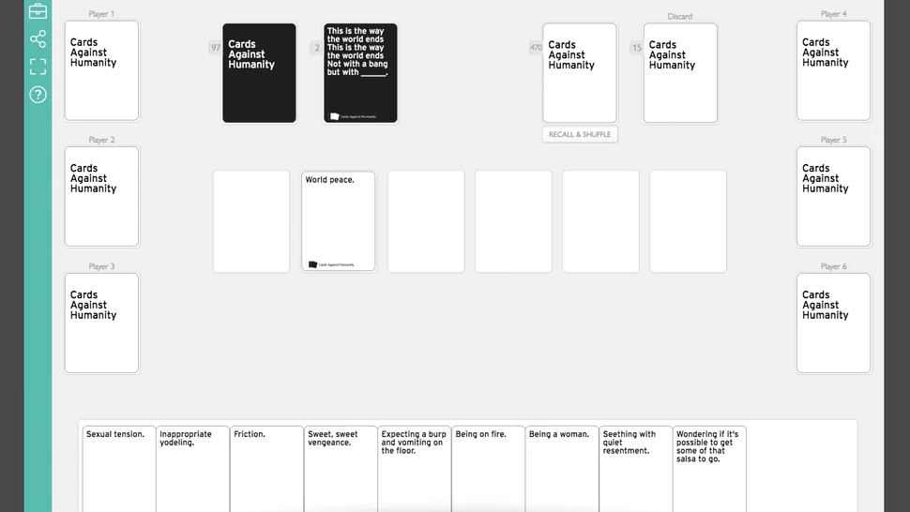
Undergraduate Level Continued
Team Building - Remember to follow the local and national guidelines in regards to gathering sizes.
These events are run by the chapter for the chapter

Slide 11
Undergraduate Level Continued
AEPi Talks
Host a Web session for Brothers to present on topics related to the fraternity, their major, or hobbies/passions.
This will help with public speaking and presentation skills.
Brothers can learn a lot about the presenters’ interests and get to know what makes them “tick”.
Brotherhood retreats
These events are run by the chapter for the chapter

Slide 12
Undergraduate Level Continued
Updating the constitution and Google Drive.
Updating and creating a budget.
Surveying the Brothers on what events they want to see next semester.
Having an online Executive Board retreat.
These are ideas of how the Chapter leadership can utilize this time to improve an plan ahead

Slide 13
Outside Organizations Level
● Northwestern’s Kellog School has online nonprofit training classes.
● Unpacked: resources about Israel.
● IAC: webinars about Israeli culture.
● Online museum tours.
● Fundraising podcasts.
● Free online books.
● Virtual field trips.
● Futurelearn: short online classes.
● 450 ivy league school classes.
● StandWithUs: online platform (Israel education).
● Improving your virtual presenting skills.
● Hillel at Home
Resources that outside organizations are providing that can help Brothers grow as individuals

Slide 14
Logistics
Zoom - Online platform for meetings.
Slack - Online platform for meetings and organization.
Padlet - Online platform for event planning and collaborating.
Twitch - Online platform to watch the Brotherhood play tournaments.
Discord - Online platform to watch the Brotherhood play tournaments.
Online resources and platforms

