Slide 1
AEPi Virtual Philanthropy
How to create and run philanthropy events virtually

Slide 2
Why Philanthropy?
Giving promotes feelings of happiness.
Helping others feels good. When you donate and help fundraise to a Cause that is important to you, you not only help them continue their vital work, you're also improving your emotional wellbeing, a win-win situation!

Slide 3
The Process
Creating an online Fundraiser on CrowdChange.
Deciding on a remote event for your chapter to do.
Pitching it to the Brotherhood.
Holding the event.
The Process only takes four easy steps

Slide 4
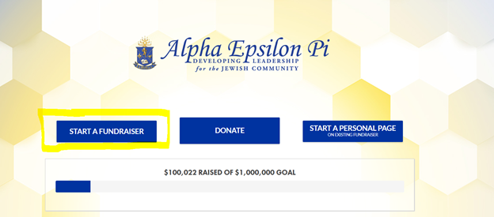
Creating an online Fundraiser on CrowdChange
Your CrowdChange fundraising page can be set up on https://aepi.crowdchange.co/ under the “start a fundraiser” button. Image below:
In order to have remote philanthropy success, there needs to be a central place to raise funds since cash will not be able to physically exchange hands go on https://aepi.crowdchange.co/ and follow these steps

Slide 5
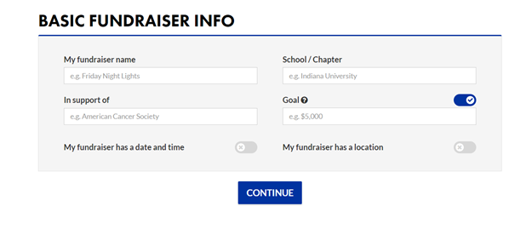
Creating an online Fundraiser on CrowdChange countuined
All relevant event information should be put into the event information box shown in the image below. Always set the goal high; it can always be changed later.
Upon successful completion, your JLPD staff member can approve the event for public use.

Slide 6
Deciding on a remote event for your Chapter to do
Text-a-thon
Brothers work together over the course of a few hours or one day to send the message below. The key to this event is having a mass number of people sending texts; this is simply a numbers game.
Here are several examples and ideas, feel free to think on more and let us know!

Slide 7
Deciding on a remote event for your Chapter to do
Continued
Here is a sample text:
Hey (NAME) ! I hope you're doing well. (Due to coronavirus, we had to cancel our philanthropy event, but we won't let that stop us). AEPi is committed to making a difference! We're trying to raise (GOAL) in (TIMEFRAME) for AEPi's Repair the World Fund, which benefits three amazing charities such as the Israel Cancer Research Fund. We're hoping you'd consider donating $18 (or more!) to help reach our goal.
(Crowdchange Link) Thank you for your help!

Slide 8
Deciding on a remote event for your Chapter to do
Continued
Letter writing campaign
The chapter writes a letter with their JLPD staff to write a letter to mail out to everyone. The staff will pring, fold, and mail the letters for you.
each Brother adds ten names and addresses onto a template, SHARE THIS WITH YOUR JLPD STAFF MEMBER.

Slide 9
Deciding on a remote event for your Chapter to do
Continued
The excel document should look like the following:
Brother | Contact Title | Contact First Name | Contact Last Name | Street Address | Apt. # | City | State | Zip
Ethan White | Mr. | Moshe | Lencer | 8550 North College Ave. | 16 | Indianapolis | IN | 46240
Ethan White | Mr. | Jason | Kirschtel | 8815 Wesleyan Rd. |  | Indianapolis | IN | 46268

Slide 10
Deciding on a remote event for your Chapter to do Continued
Social Media Postings
Making a social Media Postings that asks for people to help your cause.
Make sure to both tag people and make it as interactive as possible. Again, the key to this is doing a mass number of posts. All Brothers need to get involved in this to be a success.

Slide 11
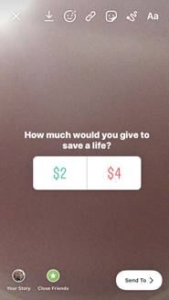
Deciding on a remote event for your Chapter to do Continued
Examples for posts

Slide 12
Deciding on a remote event for your Chapter to do Continued
Jail & bail
Have everyone in your chapter share a funny picture or post about themselves on the social media platform of their choice. Set bail at a certain fundraising goal amount. Once the amount is reached, they can delete the picture/message off of social media.

Slide 13
Deciding on a remote event for your Chapter to do Continued
See which new member class can raise the most money for AEPi’s Repair the World Fund
This can be done in concert with a text-a-thon. This is a great way to involve Brothers in a creative way.

Slide 14
Deciding on a remote event for your Chapter to do Continued
Online Video Game Tournament
Charge friends, family, Brothers or anyone to compete in a video game tournament online. Do this together with a text-a-thon or letter writing campaign.

Slide 15
Deciding on a remote event for your Chapter to do Continued
Online Philanthropy Mixer
Get a sorority/club from your college or university to work with you to raise money for AEPi’s Repair the World Fund. Remember to use your contacts! Even though you are not on campus, this is a great way to help your chapter in a social way. Everyone is looking for something to do right now. This idea can be combined with any of the fundraising methods or events listed in this document

Slide 16
Pitching it to the Brotherhood
If possible, the philanthropy chairperson should be able to give the pitch during a virtual chapter meeting. Hearing a voice will make a difference in comparison to a written group message. This is an appeal to the masses so that the chapter can get people on board to do philanthropy.
Once you choose your winning strategy, you get the rest of the Brotherhood on board!

Slide 17
Pitching it to the Brotherhood Continued
A good pitch can rally Brothers around the event. An example of a pitch is listed below:
"Brothers, even though we had to cancel/postpone our event, I still think that we can make the money we promised and make a difference! On (DATE), we are going to have an (EVENT) that will raise (GOAL) for AEPi's Repair the World Fund. In order to do this, I need everyone's help in pushing out our fundraising page on social media. We need to send this link everywhere. I also need (additional, SPECIFIC needs for event). Our chapter has the ability to make a difference and assist in saving someone's life. I cannot do this alone. Please help me make a difference! Please help me save someone's life!”

Slide 18
Holding the event!
The most important part is to go on and do whatever you chose to!

Slide 19
Logistics
Make sure you are in touch with AEPi IHQ staff to help you along any questions you might have
Set a specific date, and if needed a specific time a day.
Talk to the Chapter, the Brothers, when you personally talk about this you can get their buyin

